Slide 1
EDS Activity 1
Bhagyashri Vyankat Babalsure
CS71-18
202401080057
Amazon data set – Air Conditioner data set
https://www.kaggle.com/datasets/lokeshparab/amazon-products-dataset

Slide 2
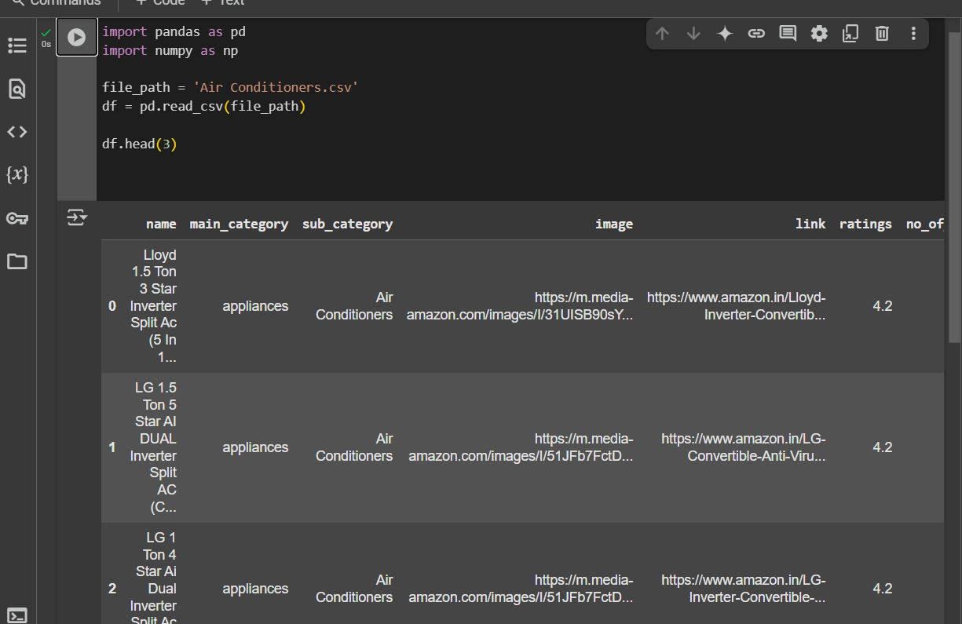
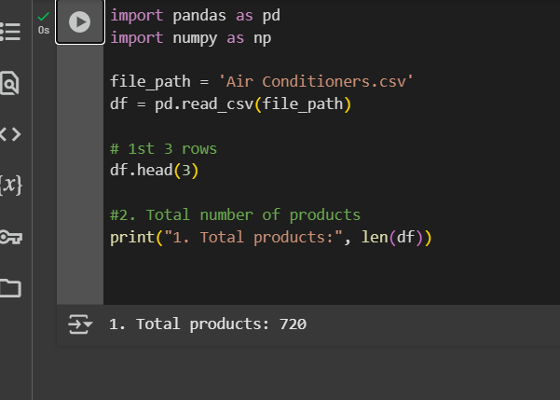
1. Top 3 Rows
2. Total no of product

Slide 3
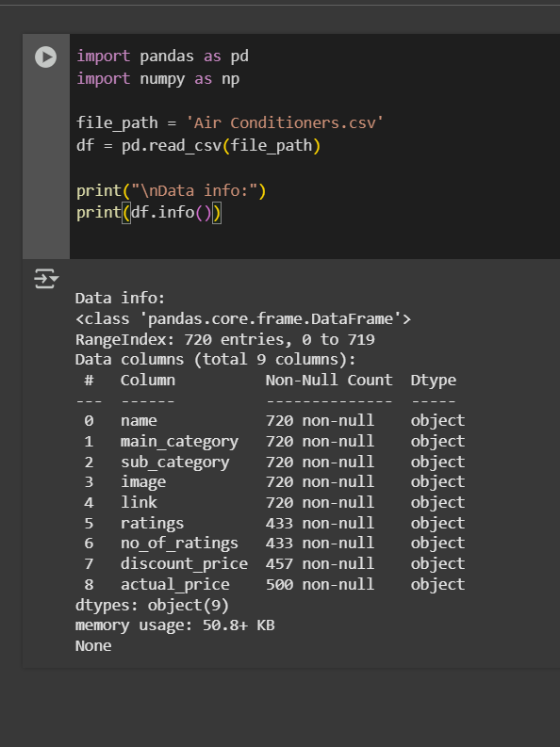
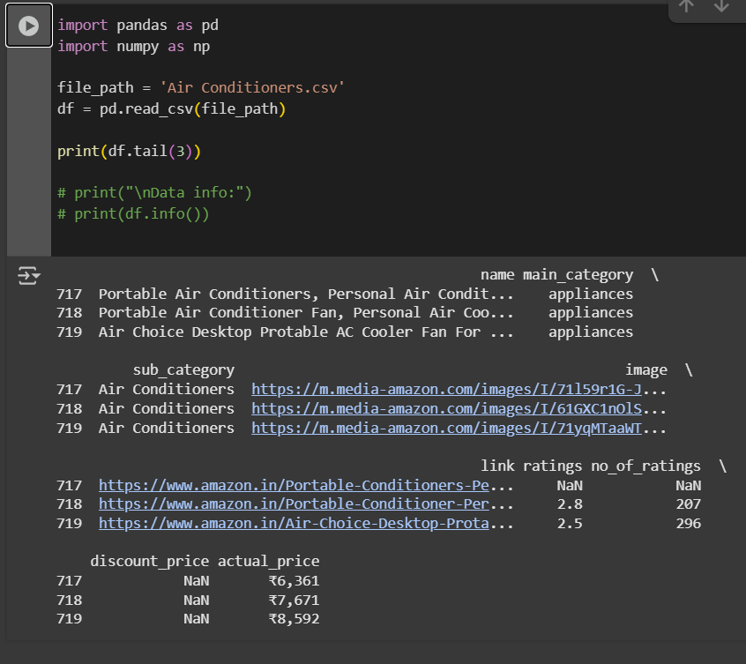
3. Information about data
4. Last 3 Rows

Slide 4
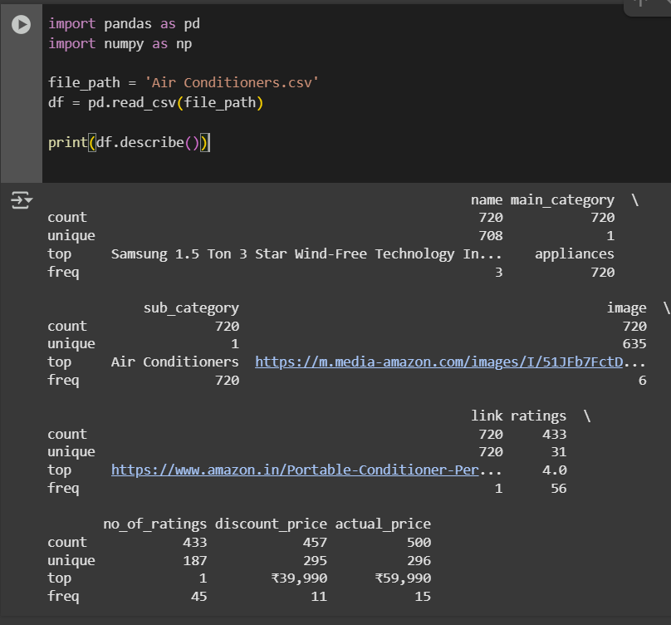
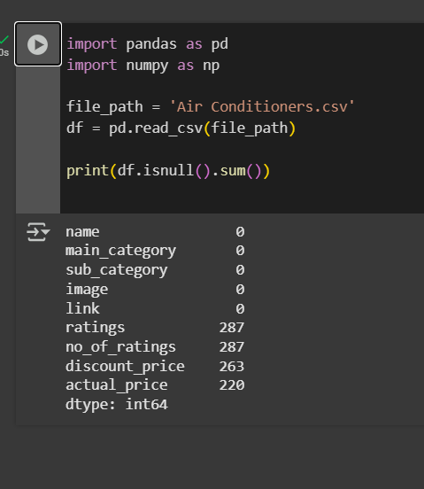
5. Get basic info and stats
6. Checking null value

Slide 5
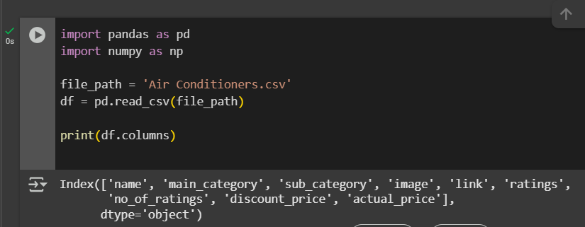
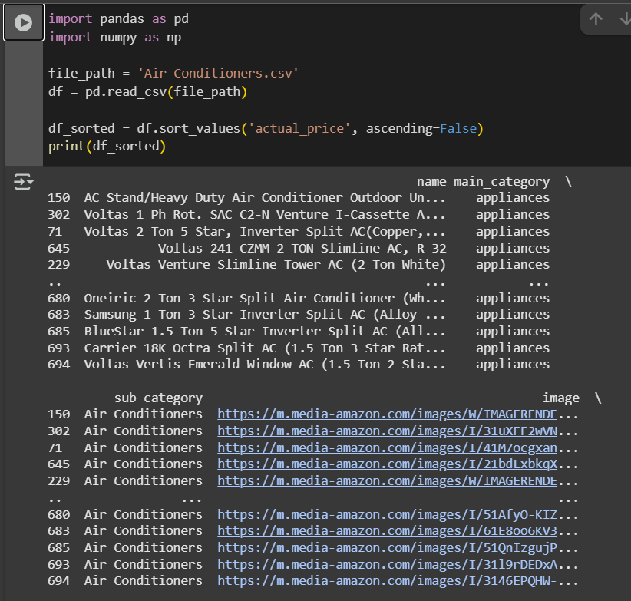
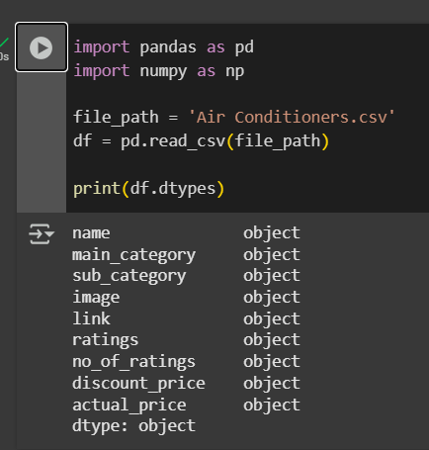
7.Column name
8. Sort Actual price in ascending order
9. Data type

Slide 6
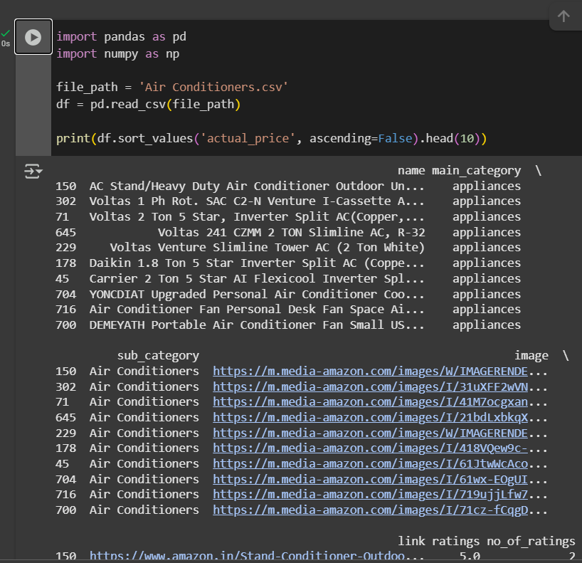
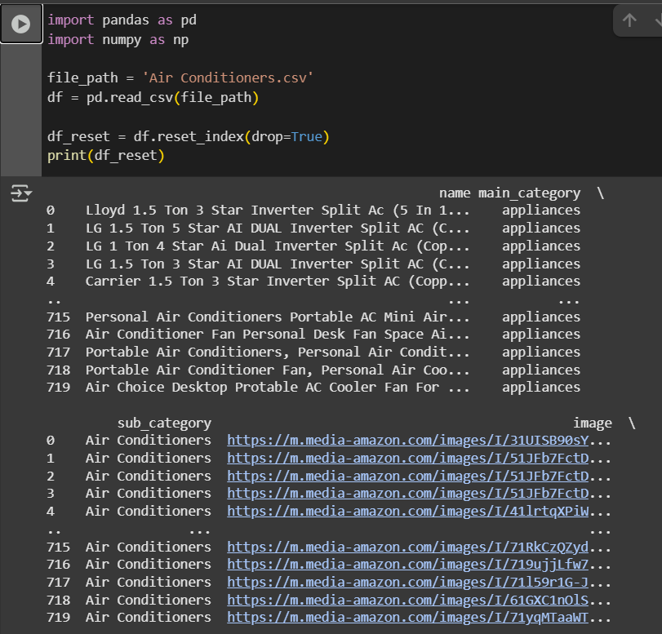
11. Sorting value
10. Resetting the index

Slide 7
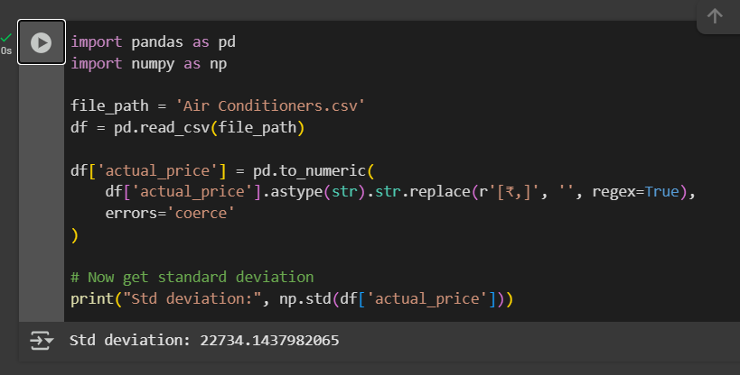
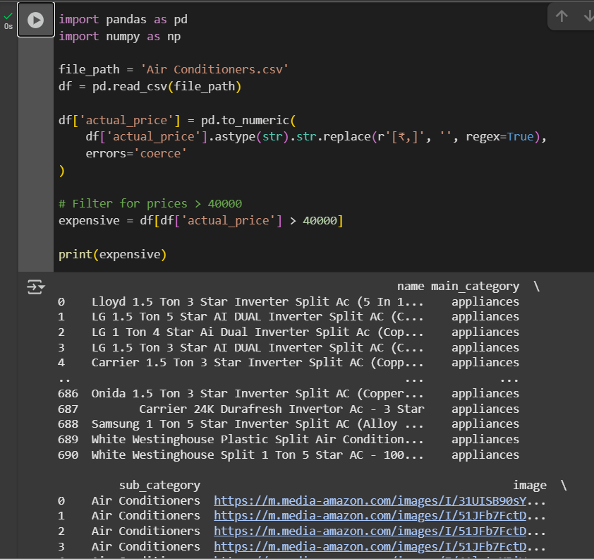
13. Filter: ACs priced above ₹40,000
12. Find out std Deviation

Slide 8
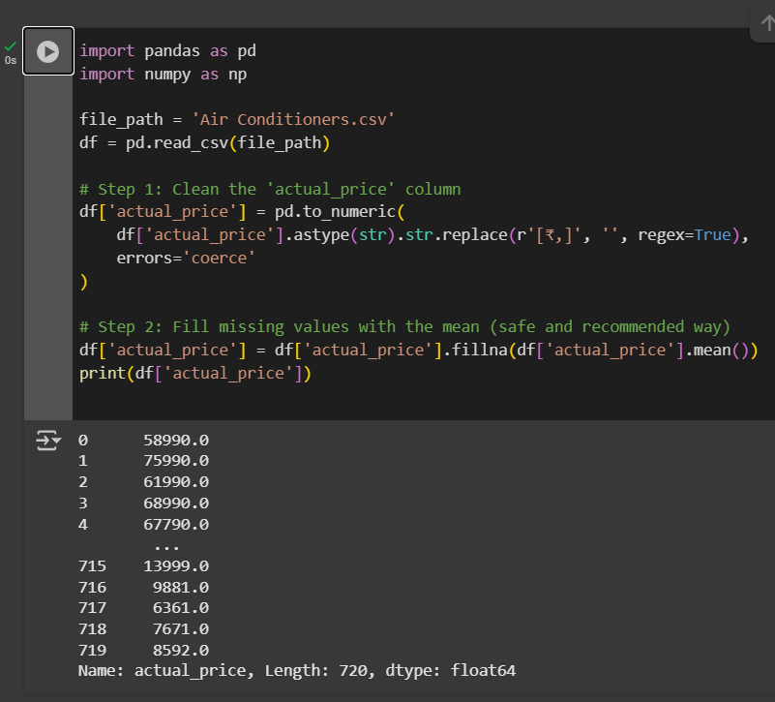
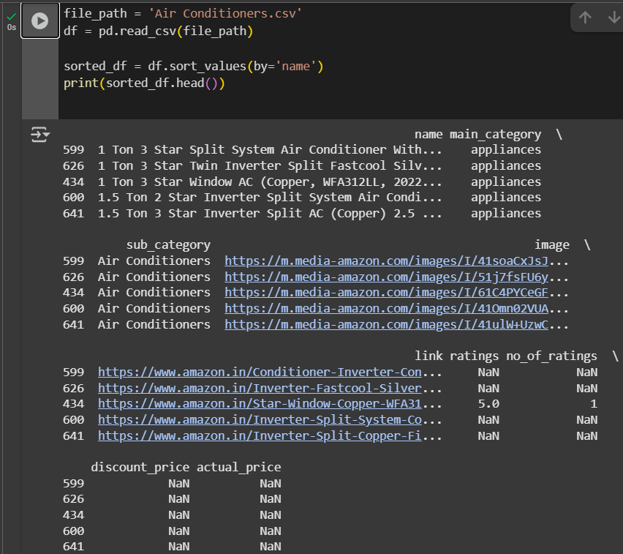
14. Fill missing prices with mean
15. Sorted by name

Slide 9
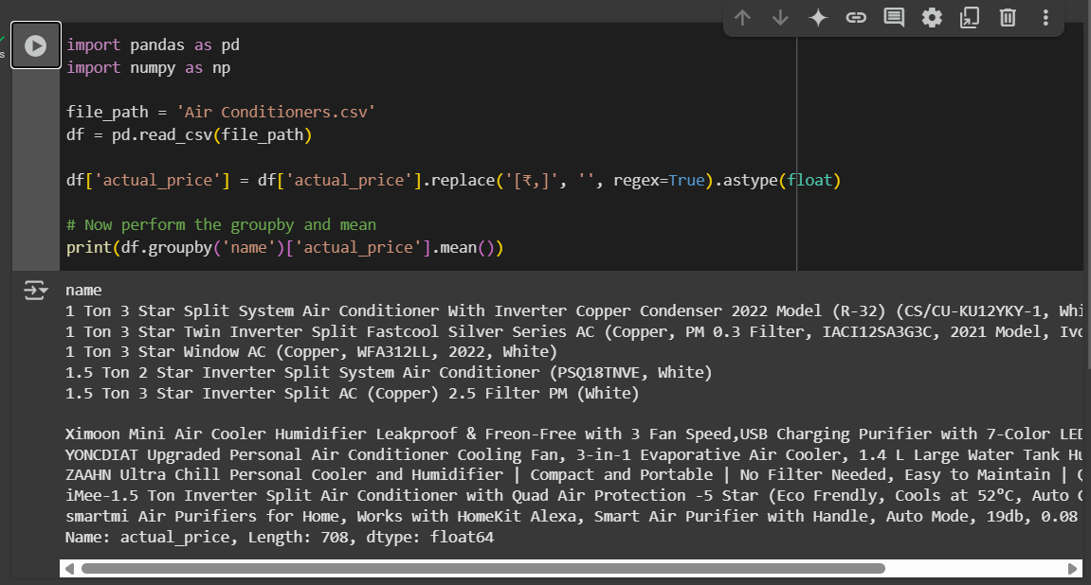
16. Group by name and actual price and mean

Slide 10
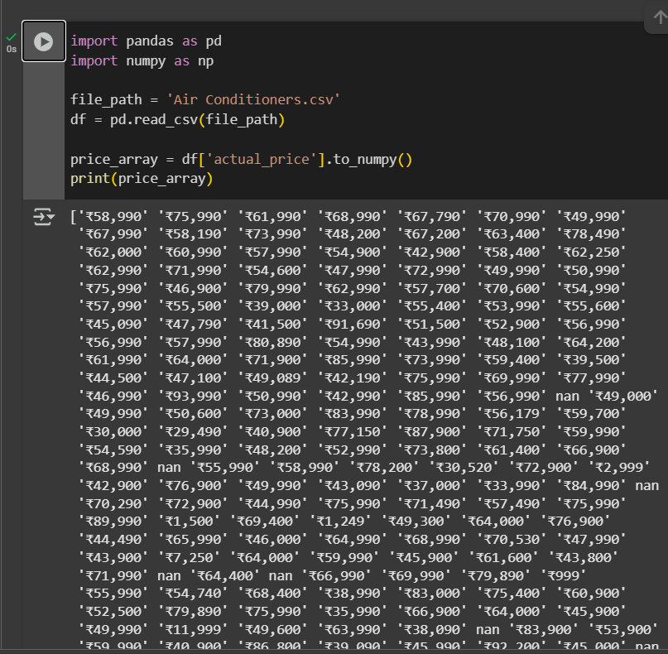
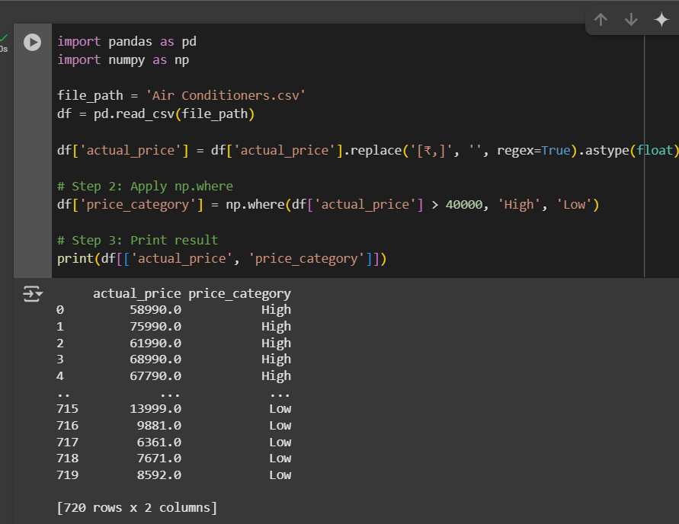
17. Create array of actual price
18. Add a column: “price category”

Slide 11
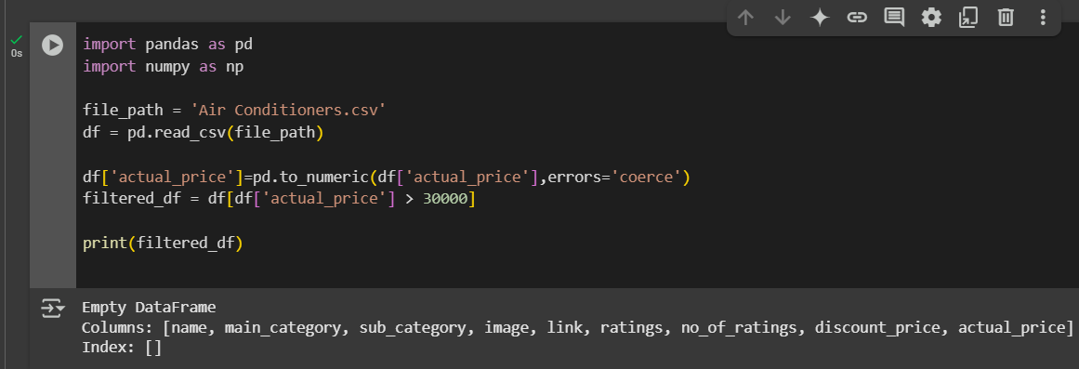
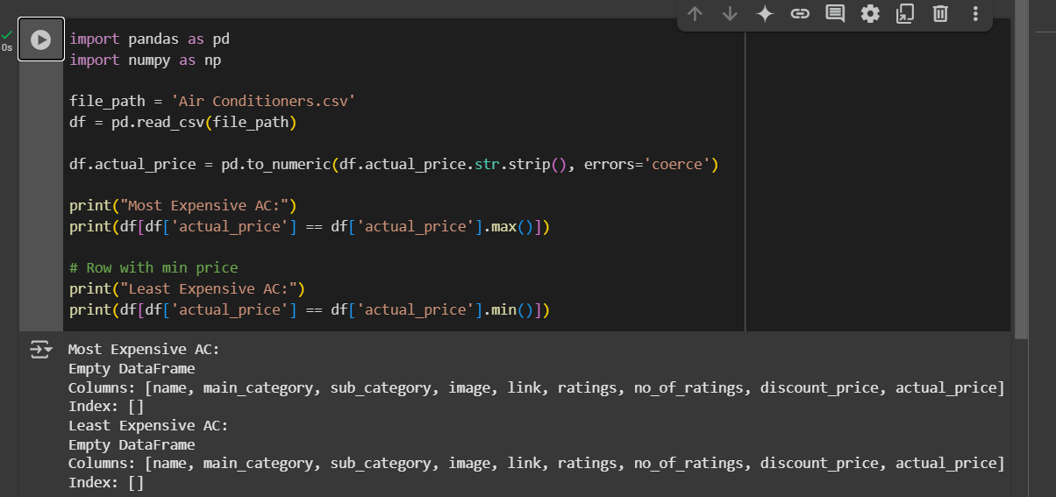
19. A product which having actual price greater than 30
20. Minimum and maximum of actual price

